Slide 1
Functional Programming for Object-Oriented Developers
Matthew O. Smith
Lambda Lounge
June 10, 2014

Slide 2
Overview
State and Value
Pure Functions
Immutability
Unlearn what you have learned

Slide 3
State and Value
Value – fixed over time
State – varies over time

Slide 4
Examples of State and Value
5
int x = 5
final int x = 5
new Long(5)
Long y = new Long(5)
final Long y=new Long(5)
new Date(1)
d = new Date(1)
final d = new Date(1)
What color should “d” be?

Slide 5
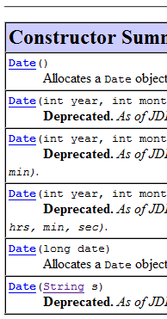
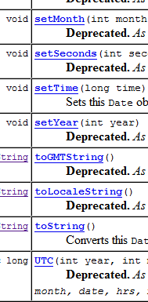
Date is the poster child for a state that should be a value
java.util.Date

Slide 6
State is everywhere
Date
beans
Collections
Arrays

Slide 7
Ways to use minimize state
Use Factories and Builders
talk to abstractions
Create immutable objects
It is a conscious decision

Slide 8
Using state and values
Minimize and localize state
Centralize state – every object needs a value, not state
Façade pattern
Favor pure functions

Slide 9
Pure Functions
Thinks “math functions”
Functions vs methods
Treating all inputs and outputs as values
Separate data from functions

Slide 10
Think Math Functions
f(x) = x * x
Inputs are values – output is a value
No side effects
No state change
arguments unaffected
calling with the same arguments yields the same results
Seriously, this is really useful.

Slide 11
Functions Vs Methods
Difference between functions and methods
Dynamic dispatch
Implied “this”
Does not matter in the least – I am going to call them functions

Slide 12
Treating all inputs as values
Code to interfaces
Never alter an input
Decorator pattern
Visitor/Iterator pattern

Slide 13
Separate data from functions
Forget “Objects should be able …”
Use Strategy pattern to define algorithms outside the values they work on

Slide 14
Demo – FunctionalDate
Value
predicates – before, after – code to interface Comparable
Could be reused with all Comparables
giving meaning - calendar – parse, format – strategy: value => value
Gregorian, Chinese, Hebrew, etc

Slide 15
The End
http://www.lispcast.com/java-learn-from-clojure

